Slide 1
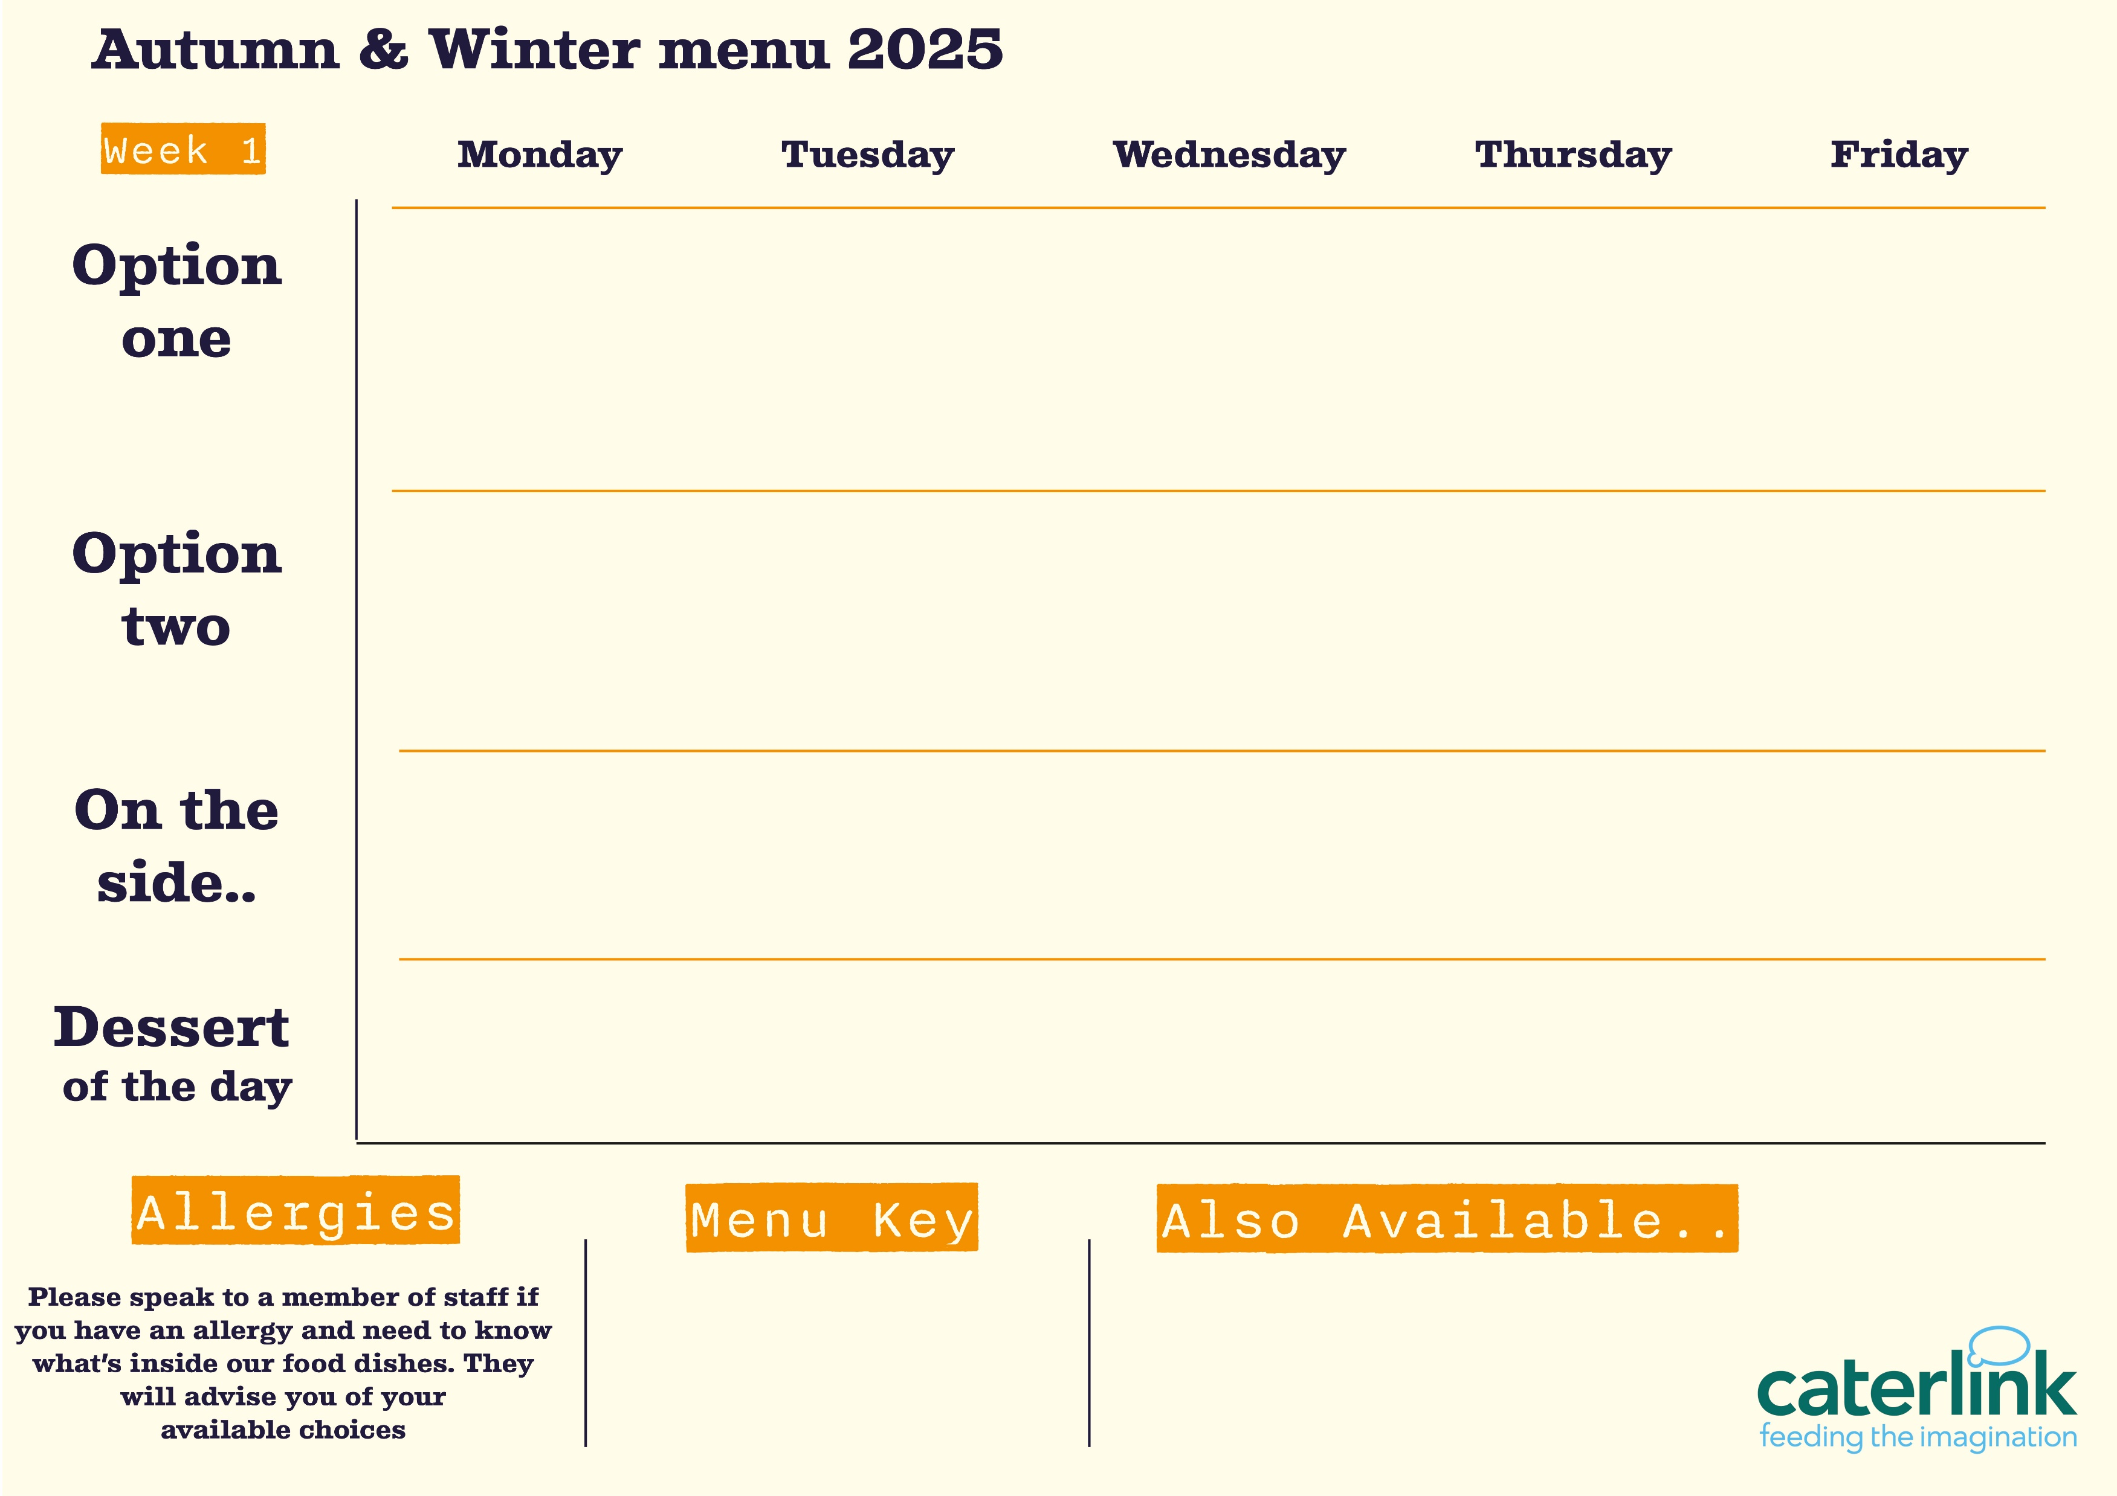




Macaroni Cheese
with crunchy garlic croutons
Mexican Beef Chilli
with 50/50 rice or soft taco
Traditional Roast Turkey
with roast potatoes & gravy
Green Thai Chicken Curry
with 50/50
rice
Fish fingers, Salmon Fish Cake or Battered Fish
with chips
Mexican Vegetable Rice
Sweet Potato Tart
with roast potatoes & gravy
Vegetarian Thai Noodles
Loaded
hound dog
with chips
Vegan Meatball Pasta Bake
with garlic bread
Mixed Salad
Salsa & Slaw
Seasonal Vegetable
Sweetcorn
Roasted Broccoli
Baked Beans
Coleslaw
School Cake
Sticky Toffee Pudding with Custard
Apple Crumble
With custard
Hot Chocolate Pudding
Lemon Drizzle Sponge
Vegan option
Our hot and cold grab & go selection alongside soup of the day and filled jacket potatoes
Added plant protein
Source of wholemeal

Slide 2


Macaroni Cheese
with crunchy garlic croutons
Butchers Sausage & Mash
with onion gravy
Chicken Tikka Masala
with 50/50
rice
Battered Fillet of fish
with chips & tartare sauce
Spicy Chicken
with Wrap or Naan
Sticky Soy & Honey Noodles
Sweet Potato, Spinach and Chickpea Korma
with 50/50
rice
Houmous & Falafel
with wrap or naan
Veggie Sausage & Mash
with onion gravy
Veggie Sausage
with chips
Mixed Salad
Red cabbage slaw
And Tabbouleh Salad
Onion and Cucumber Salad and Mango Chutney
Broccoli
Sweetcorn
Baked Beans
Garden Peas
Syrup Sponge
With custard
Lemon Drizzle
Apple & Caramel Crumble
With custard
Hot Chocolate Sponge
School Cake
Vegan option
Our hot and cold grab & go selection alongside soup of the day and filled jacket potatoes
Added plant protein
Source of wholemeal

Slide 3

Macaroni Cheese
with crunchy garlic croutons
Hot Wok Chicken Noodles
Or
Jerk Chicken
The Classic Roast Dinner
with all the trimmings
Battered Fillet of fish
with chips & tartare sauce
Chicken Korma
with 50/50
rice
Vegetarian Lasagne
with crunchy garlic croutons
Quorn and Black Bean Fajita
with 50/50
rice
Vegetarian Toad in the Hole
with all the trimmings
Vegetable Biryani
with 50/50
rice
The Big Plant Burger
with chips
Mixed Salad
Rice and Salad
Roasted carrots
And Peas
Roasted Cauliflower & Sambals
Baked Beans
Garden Peas
Hot Chocolate Sponge
Sticky Toffee Pudding
With custard
School Cake
Lemon Drizzle
Apple Crumble
With custard
Vegan option
Our hot and cold grab & go selection alongside soup of the day and filled jacket potatoes
Added plant protein
Source of wholemeal

