Slide 1
From School to College and Onto the Workplace
A Motivational Monday presentation delivered by Glenn Ettridge
Notes:
[OPENING] “Hi everyone, thanks for coming along to hear my presentation. This is about my time here at Angmering for years 10 and 11, how I then progressed onto college, then onto work. I really hope this provides you all with some useful tips for both now while you’re studying in sixth form as well as when you move onto the workplace.
[IF NOT MENTIONED BY GAVIN] – “There’ll be some time at the end of the presentation to ask any questions should you have any.”

Slide 2
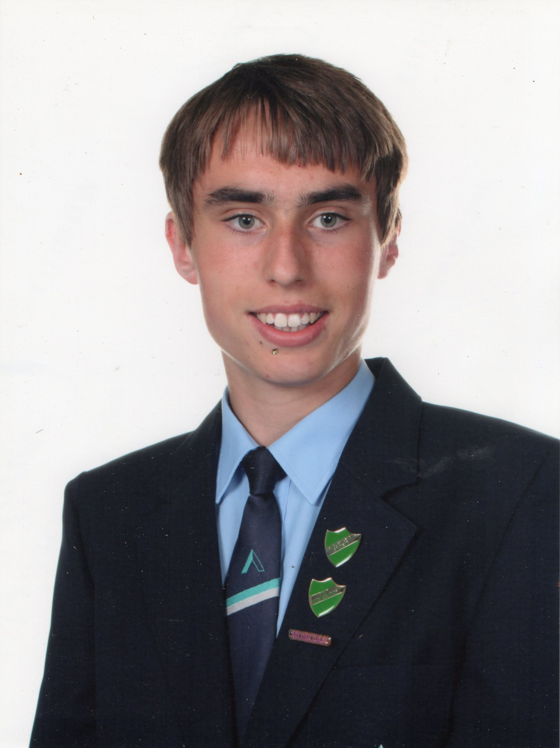
A Little Bit About Myself
I was a student at The Angmering School from 2009-2014.
After completing my GCSEs, I studied at Northbrook College.
Am now in full-time employment.
I’ve received a diagnosis of Asperger’s Syndrome, a mild form of Autism and was supported by the LNC.
Notes:
[I was a student at The Angmering School from 2009-2014.] – “And here’s me, all dressed in my uniform when I was in year 11. Had a nice time at school.”
[Am now in full-time employment] – Mention BRIEFLY you work as a business admin for WSCC’s school admissions team and will ‘talk more on this a bit later’.

Slide 3
Support I Received
Many staff knew who I was and how my Asperger’s affected my day-to-day interactions. Even those outside of the LNC.
They understood I struggled with hypersensitivity to noise. Accepted that I needed to use my noise cancelling headphones.
I struggled with certain social situations: Allowed plenty of time for me to take information in and to intervene where needed.
Had access to B15, a small room for those to socialise during breaks/lunch.
behaved a little differently.
Built a good rapport with teachers.
Notes:
[They understood I struggled with hypersensitivity to noise:] - BRING HEADPHONES WITH YOU TO SESSION to show everyone. Explain briefly about how headphones helped you.
[I struggled with certain social situations: Allowed plenty of time…] – Sometimes I can take a bit of time to register information, I need to have instructions provided to me concisely.
[behaved a little differently] “Examples: struggling with keeping eye contact, stimming etc”.
[Built a good rapport with teachers] – “They knew me and I knew them”.

Slide 4
Support from Gavin
Received excellent advice from Gavin in year 10.
Found his approach calm, knowledgeable and trustworthy.
Arranged my work experience with Ferring Country Centre.
I was invited to present to year 11 students in 2018 to motivate them for when they progressed onto further education.
Through the support provided by Gavin, he recognised that I would be able to accept challenges and progress into the workplace.
Valued Gavin’s commitment to my career aspirations whilst still at school.
Notes:
[Through the support provided by Gavin, he recognised…] “Gavin wrote a reference to be used for when I applied for job interviews. Comes in very useful.”

Slide 5
With The Support You Are Given…
You must learn to support yourself with all the advice you are given. At the end of the day, those around you, such as parents, teachers and learning support staff can only do so much.
What can you do?
Create your own timetables.
Treat yourself! – You deserve it!
Enforce self-discipline.
Notes:
[Create your own timetables] – Make it so it contains all the subjects you need to study but also to provide time for you to relax, see friends etc.
[Enforce self-discipline] For example, study the stuff you’re struggling with, not what you find most easy. Or if you have times where you can’t feel bothered to study, remember to stick it out, which leads onto the final point…
[Treat yourself! – You deserve it!] – Honestly do. You must reward yourself after your hard work.

Slide 6
School Onto College
Wanted to work in IT but couldn’t find the right course at The Angmering School…
Went onto study at Northbrook College.
  Completed a BTEC Level 3 Diploma in IT (Business) – Achieved Triple Distinction.
Gavin was supportive of my further education choices.
Point of Emphasis
When moving onto higher education, follow what YOU want to do, not where your friends go or want to study. At the end of it, it’s YOUR life, not theirs.

Slide 7
College Days
It was challenging. There were various factors;
The environment was chaotic – first year felt like I was studying on a construction site!
Unfamiliarity with others – Knew nobody from school. Was the youngest in my class.
Lack of pastoral support – While I did have some support, it was much more low-key compared to what I received from The Angmering School.
    How did I manage?
My noise cancelling headphones.
A Dictaphone my pastoral support leader lent me to record sessions.
A scribe that helped write notes.
Did I cope? Some ways yes, some ways no. But one thing kept me going…
I was there to study.
Notes:
‘I was there to study. - “That’s what you must remember. Whether this be at Sixth form or at university. You are here to study first and foremost. Think to yourself, I can’t stand it here. I can’t take much more of these lectures etc. Remember that you are here to study and if you study hard and take advantage of the help you are given, chances are that you will leave Sixth Form with grades you want”.

Slide 8
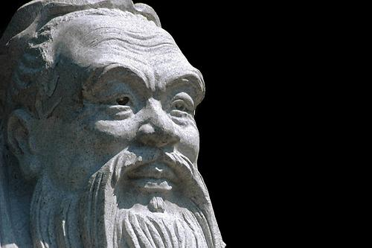
Yourselves in Sixth Form
You’re making great progress. But make sure you make use of all resources available to you;
  Online modules.
  Keep in contact with tutors.
  Maintain strong friendships.
  Ask questions. It’s never a problem to ask questions.
“The man who asks a question is a fool for a minute, the man who does not ask is a fool for life.” – Confucius c. 551 – c. 479 BCE
Remember, you never stop learning.
This Photo by Unknown Author is licensed under CC BY-NC
Notes:
[Online modules] – “I remember using Google Classroom, not sure what you use but please do use this to go back over what you studied, helped me out loads.
[Keep in contact with tutors] – “They’re there to help you”.
[Maintain strong friendships] – “I didn’t feel I had the ‘balance’ of a social/educational life while at school and college. Back to what I said about being at Sixth form or university to study, honestly, please spend time with friends when you can. Just like in work, you need a strong work/life balance. Chances are, it’ll help with your revision and getting the grades you’re after”.
Confucis (con-fyoo-shus) – born 2.5 thousand years ago. Ancient Chinese philosopher.
“I interpret his quote in the sense that if you ask a question, and feel a little silly after asking it, at least you have that information to go away with. On the other hand, if you don’t ask questions, you may end up being that ‘fool’ who never ends up knowing the right answer’. So always better to ask.
“Remember, you never stop learning.” – I’m nearly 27 and am still learning, like in regards to independent studies I’m doing. And this is said also from those who are well over double my age. [EMPHASISE BY REPEATING].

Slide 9
Onto The World of Work…
Where did I begin?
Worked as a ‘Business Administrator Apprentice’ at a small, family-run marketing firm in Littlehampton. Was there for about 16 months.
Provided me with the sense of satisfaction. Was earning my own money… Yet being paid pitiful amounts!
I worked hard. Though, was a timid guy.
It took many years for me to become more self-assertive.
Notes:
[Worked as a business administrator apprentice…] – “Rather enjoyed me time, did very bland work, usually data-sourcing and was there for about 16 months.
[Provided me with the sense of satisfaction…] – Was only earning about £450 a month, was living with mum and dad so no need to worry too about my outgoings.

Slide 10
Where I am Today
Working as a Business Administrator for West Sussex County Council’s Pupil Admissions team.
There’s lots going on, including:
  Taking calls from parents, schools and other local authorities.
  Processing various applications.
  Responding to email queries.
And have had to take an excessive amount of information over the past six years.
Despite having a secure job in the local authority. I am keen to change career. Interested in becoming a front-end developer.
With any job, comes the right attitude.
Notes:
[With any job, comes the right attitude]. Mention Quote from dad “You can teach skills, you can teach knowledge, but you can’t teach attitude.”. – Give example.

Slide 11
Getting Into The World of Work
Some of you may be working part-time already, for those who aren’t yet working, remember to be;
Confident – Managers like this. Customers appreciate it.
Assertive – If you’re assertive, colleagues should respect you more.
Knowledgeable – Take an active interest in your job, even if at first you find the process challenging.
  Recognise your part in the job. It will help with your wellbeing when things get tough.
Bold – Stand out from the crowd.
  They may do the bare minimum. You go further.
  Do a little bit extra. It can go a long way.
Trusting of your instincts:
  May be times where things aren’t clear. Do what you think is right. Not what others expect you to
Notes:
‘Recognise your part in the job. It will help with your wellbeing when things get tough. ’ – Mention how even as you, an admin for pupil admissions, you are playing a key role in helping children and young people into schools.

Slide 12
Something to Take Away
No matter what you end up doing, be proud that you managed to get that position
A little quote from my dad...
“If you are a bin collector, you be the best bin collector there is.”
  His quote means that regardless of your job, be the best version of yourself to do said job. Ignore those who:
  Job shame.
  Are lazy.
  Don’t have the same strong work attitude as you.
At the end of the day, you take accountability of your own actions, not of other peoples’.

Slide 13
Now over to You…
Thanks For Listening!
Any questions?
Notes:
Summary: ‘So I hope this has given you an idea of how The Angmering School and the staff helped me to cope, and have allowed me to progress onto college, then into the workplace of where I have taken all I’ve learnt, as well as stuff I’ve learnt myself along the way, to cope and be a valued member of my workforce..
CONT’D - Again, listen to advice given to you, whether you take it or not, the decision is all with you.”
Now it’s over to you, does anyone have any questions or want me to clarify anything?”

