Slide 1
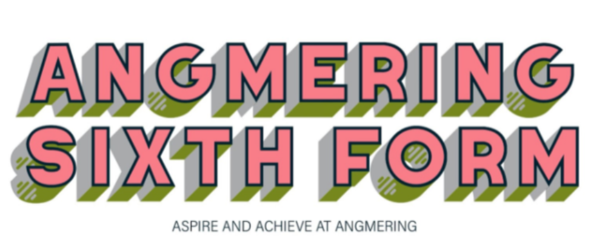
The Angmering 6th Form
Year 12 Parent Information Evening
2022/2024

Slide 2
Topics to cover
Academic Calendar
Option Choices
Supporting students
Parental Support

Slide 3
Academic Calendar
September – Target setting
October –
    Initial assessment
    Course placement review
November - UCAS trip to Amex 11/11
January - First AR feedback for parents
February – Parents eve
March - Mock exams

Slide 4
Academic calendar (cont.)
June – Public and internal exams
  UCAS information evening (date TBA)
  Open days at universities
July - Exam review and work experience
  Formal lessons cease on Friday 14th July
  Work experience for all commencing Monday 17th July
October - UCAS early entry deadline
November - Yr13 mock exams
January - UCAS deadline for all courses
March - Final mock exams
May 2024 - A level exams commence

Slide 5
Options
Most students take 3 subjects in Year 12.
More academic students may wish to complete an additional AS
4 subjects until October?
Subject choice should be determined by level of interest/enjoyment and any specific requirements of the course the student wishes to study.
English and Maths GCSE resits

Slide 6
Supporting Students
Alps Targets
Based on GCSE results
Students score points for each GCSE grade 9 =8 points, 8=7…..G=1
Average score per GCSE taken

Slide 7
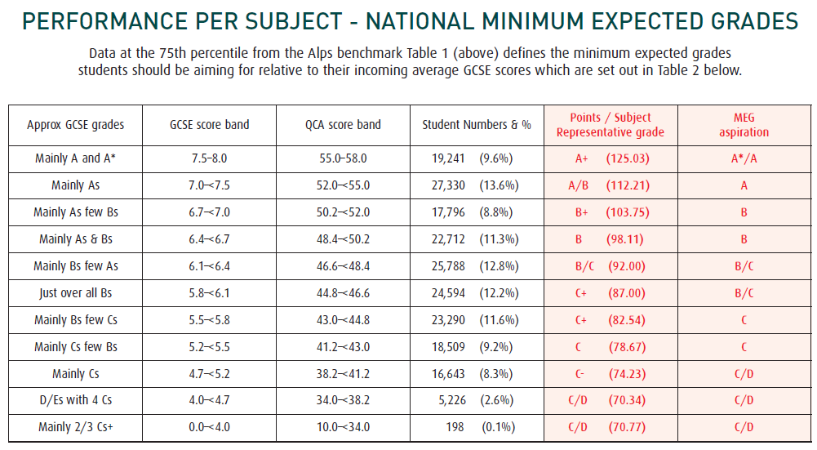

Slide 8
Supporting Students
Daily registration and Assembly
Study periods
Tailored tutor programme
Attendance monitoring
Exam entries and resits
Bursary
Text books
Missed deadlines
Folder checks
Sanctions (classcharts)
Period 10
High expectations (independent work- 4 hours)

Slide 9
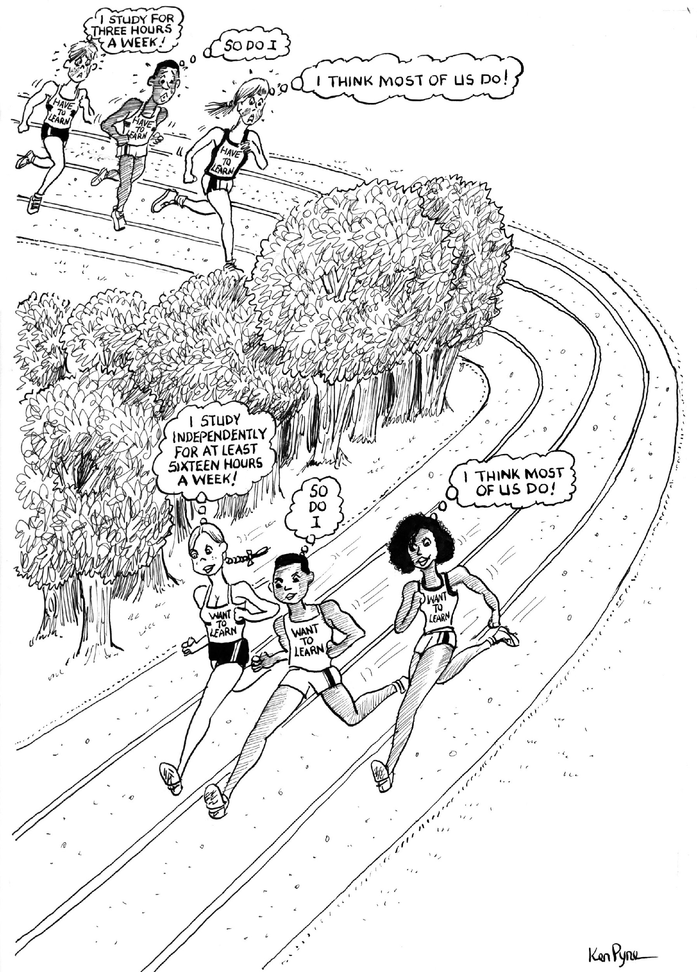

Slide 10
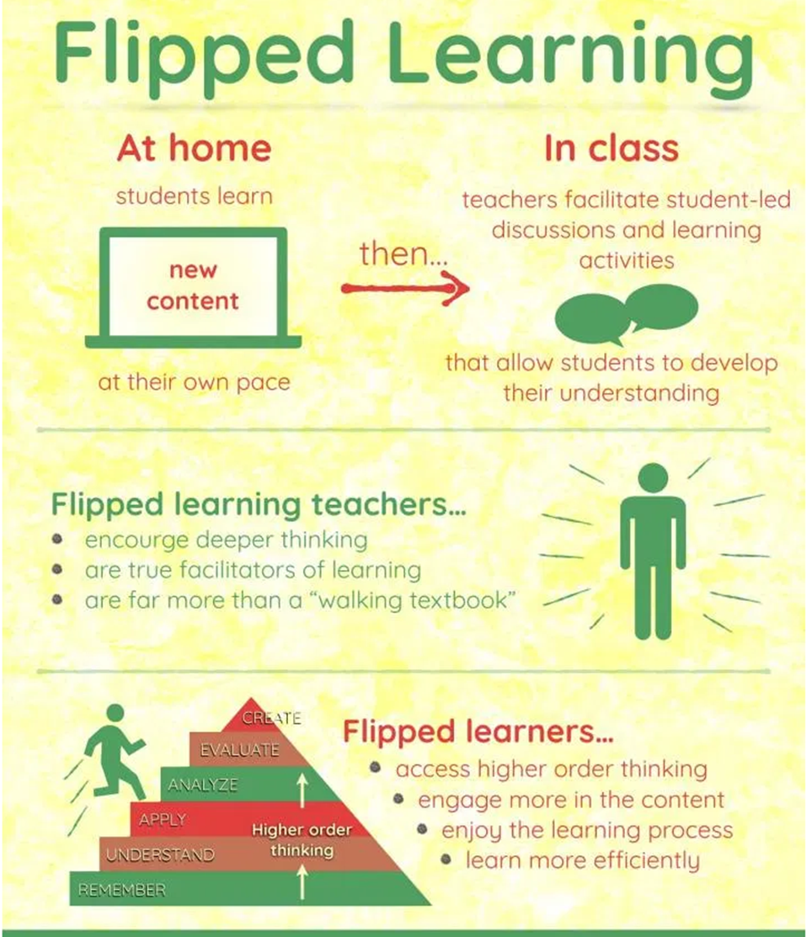

Slide 11
Parental Support
2 interim reviews
Parent evening
Contact details
  Tutors
  Subject teachers
  Emily Hughes - Pastoral Manager
  akerrison@theangmeringschool.co.uk

Slide 12
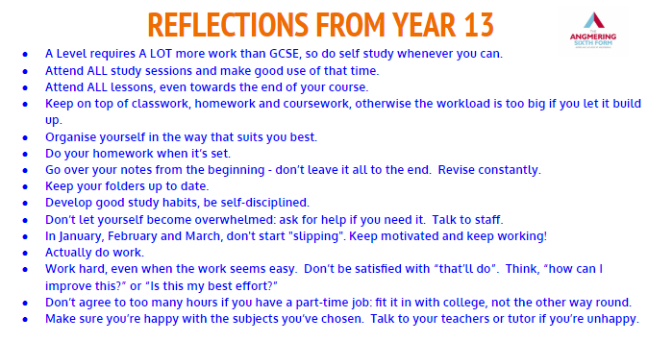

Slide 13
Extra curricular activities
Sports academies
Duke of Edinburgh award
EPQ
Paid roles within the school
Volunteering opportunities (NCS)
Charitable events
University and subject based visits
Peer mentoring/Literacy support
Wednesday P5

Slide 14
And finally….
Website
Can you help??

