Slide 1
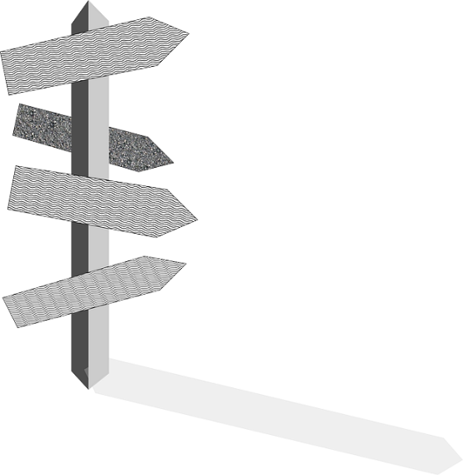
Art, craft and design
Learning Journey 2021
Creativity
Resilience
Health and Safety
Problem-solving
Independence
Literacy
Critical thinking
Communication
Key Stage 3
Key Stage 4
Key Stage 5
Experimenting with media
Presentation skills
Resolve project through a final outcome
Summer exhibition
Developing original ideas
A-levels
BTEC
Apprenticeship
University and/or
career in the creative industries
Externally set assignment
Post-16
destination
Analytical and evaluative writing
Lasts ten weeks
Evidence
skills
Demonstrate independence
Formally assessed and moderated
40% total mark
10 hours of supervised time
Own choice of 2 artists
Theme, concept or idea?
Observational skills
Externally set assignment from AQA
Becomes final coursework project
Formally assessed
Art, craft or design-led
2D or 3D focus
YEAR
Research
skills
Personal project (trial exam)
11
Externally set assignment from AQA
Resolve project through a final outcome
Presentation
skills
Experimenting with media
Developing original ideas
Analytical and evaluative writing
Observational skills
Research skills
Paint mediums
Artefacts
Natural forms
Sea creatures
Seascapes
Colour theory and paint
Meaning/ narrative
Countries and cultures
Pattern and colour
Identity
Environment and wildlife
Man-made objects
Craft
Painting on canvas
Our Blue Planet
Pattern and Culture
Compositional devices
Local seaside
Painting
Printmaking
Sculpture
Collage
Mixed media
Drawing
Reduction printing
Presentation skills
Developing ideas/ making connections
The environment
Drawing
3D Clay hand building and glazes
YEAR
2D & 3D
Photography
Drawing
2D and 3D
Mixed media
Drawing
Painting
10
Issues
Art on Walls
Animals
Drawing
Personal choice of artists
Opinions and ideas
Art as expression
Creative career input
Art and society
History of graffiti
Contemporary ceramics
Anatomical drawing
YEAR
9
YEAR
Colour and emotion
Sea shanties, stories and poems
Traditional and
contemporary
artists
Conceptual/ performance art
9
Proportions of the face
Identity
History of portraiture
Local history
Myths and Legends
Pop Art
Everyday objects/ food
YEAR
Identity
Stories from the Sea
Pop and Crisps
8
Photography
Painting
Typography and calligrams
Research skills
Drawing
Drawing
Etching
Relief printing
Drawing
Soft sculpture
3D construction techniques
Installation art
Perspective, space and depth
Diverse range of artists
3D artists: Fabric Lenny
Local artists
Local places of interest
Form
Shape
Texture
Pattern
Colour
Tone
Line
Mark-making and relief
Make it!
YEAR
Working with others
Local Landscapes
The Formal Elements
7
Design process
Drawing
Textiles:
Weaving/ Fuse and stitch
Dioramas
Painting
Drawing
Baseline assessment
Printing
Clay
Sculpture
Collage
Painting
Drawing

